Slide 1
Efficiency of an information literacy courses for Ph.D. students at the Faculty of Medicine, Masaryk University

Slide 2
Why the courses exists?
The need of developing PhD students‘ information literacy skills:
Searching scientific informations
Evaluatin of information sources
Scientific writing
Citing
From 2000 to spring 2016 – face-to-face From autumn 2014 to spring 2016 – e-learning

Slide 3
About the courses
DSVIz01 Acquisition of scientific information
Block teaching (2 lessons x 3 hours)
DSVIz01e Acquisition of scientific information–e–learning
E-learning
Both courses are:
compulsory for 5 credits
only for PhD students from the Faculty of Medicine

Slide 4
The courses contents
Main Topics
Searching in EIR (discovery.muni, WoS, Scopus, PubMed)
Publication and citation ethics, citing
Zotero
Scientometrics (impact factor, SJR, SNIP, h-index)
Additional Topics*
Predatory journals
ORCID, ResearcherID,
Open Access
* Only via electronical materials (videos, PDFs)

Slide 6
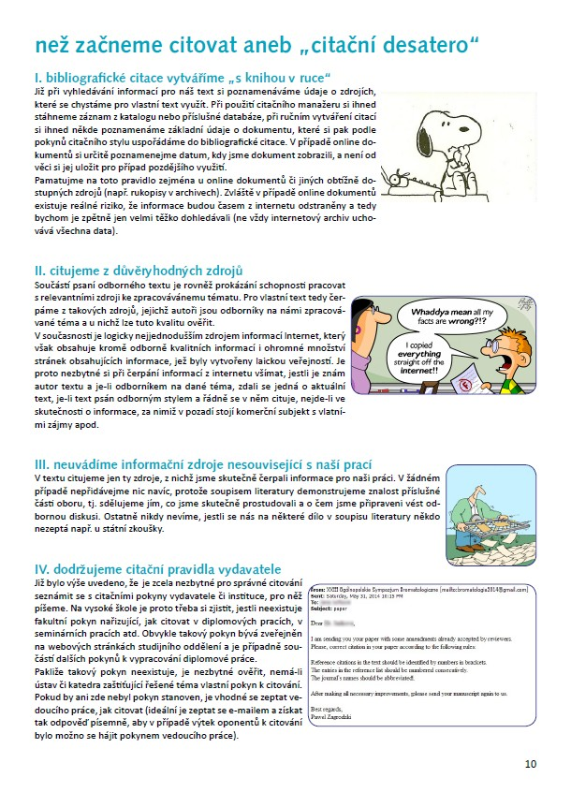
Study support for both courses

Slide 7
Evaluation of teaching efficiency due to the time spent by teaching/tutoring
Continously counting number of minutes spent by any process (checking homeworks, responding etc.) in terms spring and autumn 2015
Comparison of an average and a percentage of a time spent by processes

Slide 8
Evaluation of teaching efficiency due to the time spent by teaching/tutoring
Processes | F2F (block teaching) |  | E-learning
 | spring 2015 | autumn 2015 | spring 2015 | autumn 2015
Contact teaching | 635,0 | 490,0 | 0,0 | 0,0
Preparing an interactive syllabi | 53,0 | 97,5 | 44,0 | 99,0
Preparing tests | 15,5 | 12,0 | 7,0 | 11,5
Checking tasks | 480,0 | 552,0 | 416,0 | 632,5
Preparing study materials | 0,0 | 13,0 | 0,0 | 0,0
Preparing information about the courses at the websites | 0,0 | 97,0 | 0,0 | 15,0
Preparing tasks | 4,0 | 0,0 | 14,0 | 34,0
Communication with students | 149,5 | 115,5 | 218,0 | 175,5
TOTAL MINUTES | 1 337,0 | 1 377,0 | 699,0 | 967,5
TOTAL HOURS | 22hrs 20mins | 22hrs 55mins | 11hrs 40mins | 16hrs 10mins
Number of students | 22 | 21 | 12 | 17
Average number of minutes on each student | 32 + 635 | 42 + 490 | 58 | 57

Slide 9
Evaluation of teaching efficiency due to the time spent by teaching/tutoring

Slide 10
Measuring the impact of teaching on PhD students‘ knowledge
Measuring based on pre-tests and post-tests
Same pre-tests/post-testy for F2F and e-learning
Comparison of only results from students with completed both tests
Detecting the percentage difference between the number of people who correctly answered question

Slide 15
Evaluation of PhD student´s satisfaction with courses
Survey in Google Docs (closed and Likert scale questions, comments)
Each semester evaluation
Negativ - a low return of surveys

Slide 21
Summary
Similar time-consumption for similar number of students
Most of students increased their knowledge in both types of learning
Same questions answered incorrectly in both types of learning
Most of students satisfied with courses contents and tasks in both types of learning

Slide 22
Future
Since autumn 2016 both courses merged into a blended learning
New topic in every third week
Voluntary participation in a practical training every second and third week

Slide 23
Thank you for your attention Jiří Kratochvíl University Campus Library kratec@ukb.muni.cz www.kratec.cz - Publikace

